Slide 1
Introduction to Spring Framework
Raisa Islam

Slide 2
Spring Framework
Most popular application development framework for Java
Core features of spring framework can be used in developing any Java application
Provides extensions for building web applications on Java EE platform
Spring enables to build application from “Plain Old Java Object” (POJO)

Slide 3
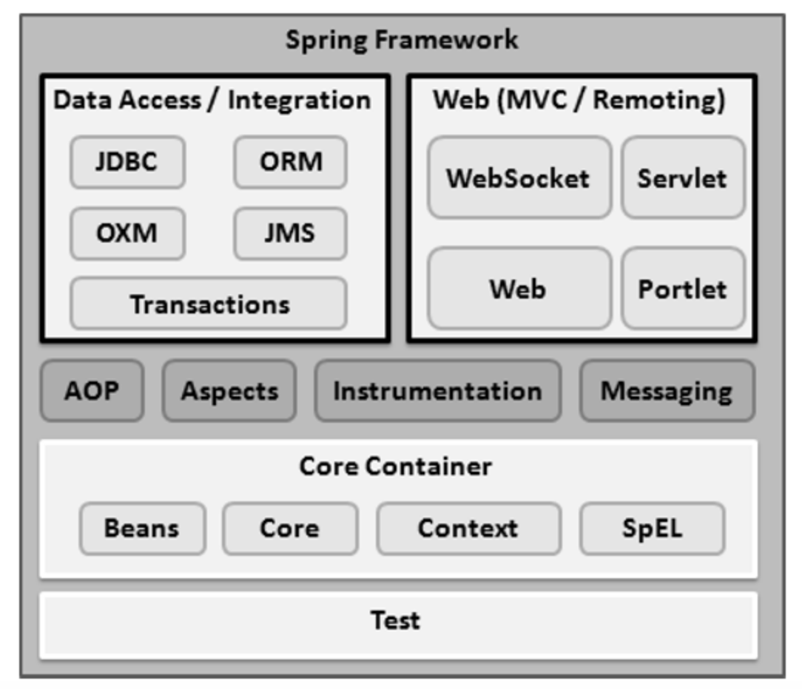
Spring Framework Components

Slide 4
Core Container
The Core module provides fundamental parts of the framework including “Inversion of control” (IoC) and “Dependency Injection” (DI) features
The Bean module provides BeanFactory, which is a implementation of the factory pattern
The Context module builds on the solid base provided by the Core and Beans modules and it is a medium to access any objects defined and configured.
The ApplicationContext interface is the focal point of the Context module
The SpEL module provides a powerful expression language for querying and manipulating an object graph at runtime

Slide 5
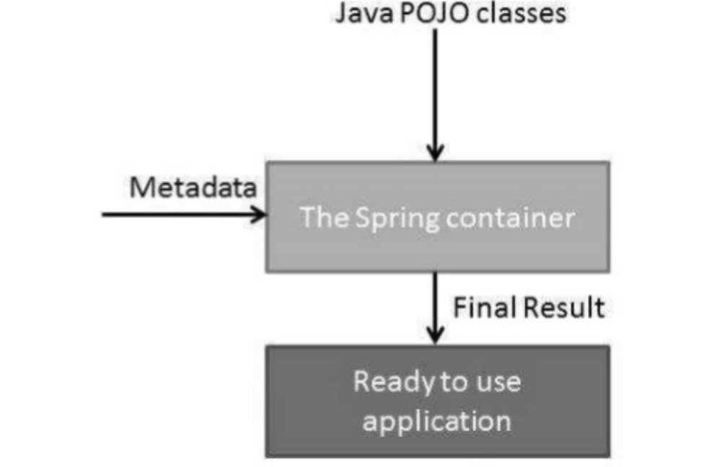
Inversion of Control
Inversion of control (IoC) is a programming technique in which object coupling is bound at run time by an assembler object and is typically not known at compile time using static analysis
Spring IoC container is the core of Spring Framework. The container will create the objects, wire them together, configure them, and manage their complete life cycle from creation till destruction
The container gets its instructions on what objects to instantiate, configure, and assemble by reading the configuration metadata provided

Slide 6
Bean
A bean is an object that is instantiated, assembled, and otherwise managed by a Spring IoC container
created with the configuration metadata that you supply to the container
Spring Bean Factory container contains basic support for DI
Most commonly used BeanFactory implementation is XmlBeanFactory class

Slide 7
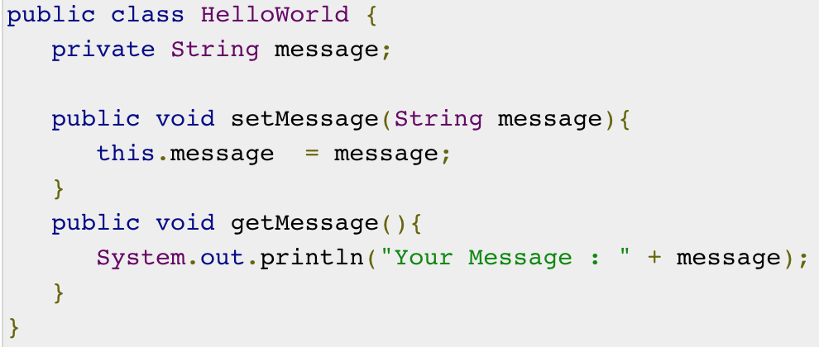
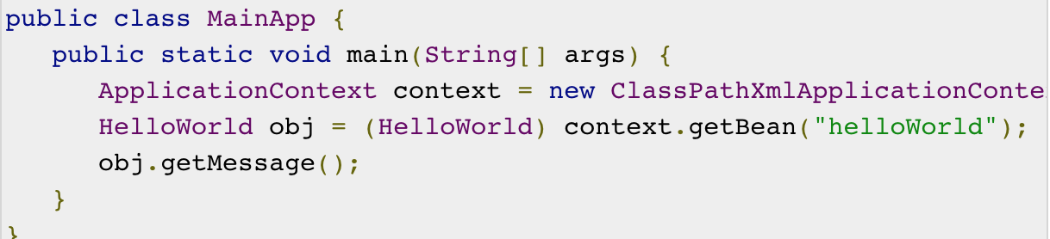
Bean Example

Slide 8
Spring Framework Components

Slide 9
Data Access/Integration
The JDBC module provides a JDBC-abstraction layer that removes the need for tedious JDBC related coding
The ORM module provides integration layers for popular object-relational mapping APIs, including JPA, JDO, Hibernate, and iBatis
The OXM module provides an abstraction layer that supports Object/XML mapping implementations for JAXB, Castor, XMLBeans, JiBX and XStream
The Java Messaging Service JMS module contains features for producing and consuming messages
The Transaction module supports programmatic and declarative transaction management for classes that implement special interfaces and for all POJOs

Slide 10
Transaction Management
A database transaction is a sequence of actions that are treated as a single unit of work
Four key properties described as ACID
Atomicity: A transaction should be treated as a single unit of operation, which means either the entire sequence of operations is successful or unsuccessful
Consistency: This represents the consistency of the referential integrity of the database, unique primary keys in tables, etc.
Isolation: There may be many transaction processing with the same data set at the same time. Each transaction should be isolated from others to prevent data corruption
Durability: Once a transaction has completed, the results of this transaction have to be made permanent and cannot be erased from the database due to system failure

Slide 11
Spring Framework Components

Slide 12
WEB
The Web module provides basic web-oriented integration features such as multipart file-upload functionality and the initialization of the IoC container using servlet listeners and a web-oriented application context
The Web-MVC module contains Spring's Model-View-Controller (MVC) implementation for web applications
The Web-Socket module provides support for WebSocket-based, two-way communication between the client and the server in web applications
The Web-Portlet module provides the MVC implementation to be used in a portlet environment and mirrors the functionality of Web-Servlet module

Slide 13
MVC architecture
The MVC pattern results in separating different aspects of an application while providing loose coupling between them
Three main logic components
The Model encapsulates the application data and in general consists of POJOs
The View is responsible for rendering model data and in general generates HTML output that can be interpreted by client browser
The Controller acts as interface between the Model and the View. It is responsible for processing user requests and building an appropriate model and passes it to view for rendering

Slide 14
Environment Setup
Step 1: Setup Java Development Kit (JDK)
Step 2: Install Apache common logging API
Step 3: Setup Eclipse IDE
Step 4: Setup Spring Framework Libraries
Environment setup : https://www.tutorialspoint.com/spring/spring_environment_setup.htm
Create project: https://www.tutorialspoint.com/spring/spring_hello_world_example.htm

Slide 15
Spring framework for GBI
Clone Project:
git clone https://github.com/GreenButtonAlliance/OpenESPI-ThirdParty-java.git
cd OpenESPI-ThirdParty-java/
Build and start Tomcat using maven:
mvn tomcat7:run
Applications will be available at localhost port 9000
Building:
# for the default test profile
mvn clean install
# or for a specific profile
mvn -P <profile name> -Dmaven.test.skip=true clean install

Slide 16
Spring framework for GBI
IDE setup: Spring Tool Suit
Open STS and import existing Maven project
Right click on project and select RunOnServer
To start server
Sudo /home/bitnami/springsource/vfabric-tc-server-developer-2.9.3.RELEASE/base-instance/bin/tcruntime-ctl.sh start
To stop server
Sudo /home/bitnami/springsource/vfabric-tc-server-developer-2.9.3.RELEASE/base-instance/bin/tcruntime-ctl.sh stop
Unit Test
mvn test
Link: https://github.com/GreenButtonAlliance/OpenESPI-ThirdParty-java
Link: https://github.com/GreenButtonAlliance/spring-authorization-server

Slide 17
Reference
https://www.tutorialspoint.com/spring
https://github.com/GreenButtonAlliance?language=java

